Slide 1


BLOOD DONATION MANAGEMENT SYSTEM
SUPERVISOR Mr.A.Malarmannan,M.E., AP/CSE.
PRESENTED BY
2303811710422159 – SRIVARSHINI S

Slide 2

PRESENTATION OVERVIEW
Objective
Project Introduction
Problem Statement
Methodologies (Programming concepts relevant to problem statement)
Architecture of the proposed system
List of Modules
7. Merits
8. Results and Discussion
9. Queries

Slide 3
OBJECTIVE
The Blood Donation Management System simplifies the blood donation process for both donors and blood banks. It allows donors to register, schedule donations, and track their donation history. Blood banks can manage donor records, monitor inventory levels, and organize donation drives. The system reduces manual tasks, increases efficiency, and sends automated reminders to donors. It ensures secure data storage and protects donor information. Additionally, the system is scalable to handle multiple locations and large volumes of data.

Slide 4
PROJECT INTRODUCTION
This system aims to create an integrated solution that serves both blood donors and blood banks. Donors can register, schedule donation appointments, and track their donation history. Blood banks can manage their donor database, keep track of blood inventory, and organize donation drives more effectively. The system should be user-friendly, accessible to both healthcare organizations and donors, and capable of handling large volumes of data securely.

Slide 5
PROBLEM STATEMENT
Managing blood donations and donor data manually or with outdated systems leads to inefficiency, errors, and delays. Blood banks often struggle to maintain accurate records of donors and blood inventory, and there is a lack of centralized platforms for scheduling donations. The absence of an automated solution results in missed opportunities for organizing donation drives, inadequate tracking of inventory, and poor communication with donors.

Slide 6
Methodologies (Programming concepts relevant to problem statement)
Object-Oriented Programming (OOP): Encapsulation, inheritance, and polymorphism to manage entities like donors, donations, and inventory.
Event-Driven Programming: Utilizing event listeners and handlers to respond to user interactions, such as button clicks for registration, scheduling, and inventory updates.
File I/O or Database Integration: To persistently store and retrieve donor information, donation history, and inventory levels.
GUI Development: Using Java Swing or AWT for building the graphical user interface to interact with users.
Validation: Input validation for fields like donor name, age, blood type, and scheduled donation dates.

Slide 7
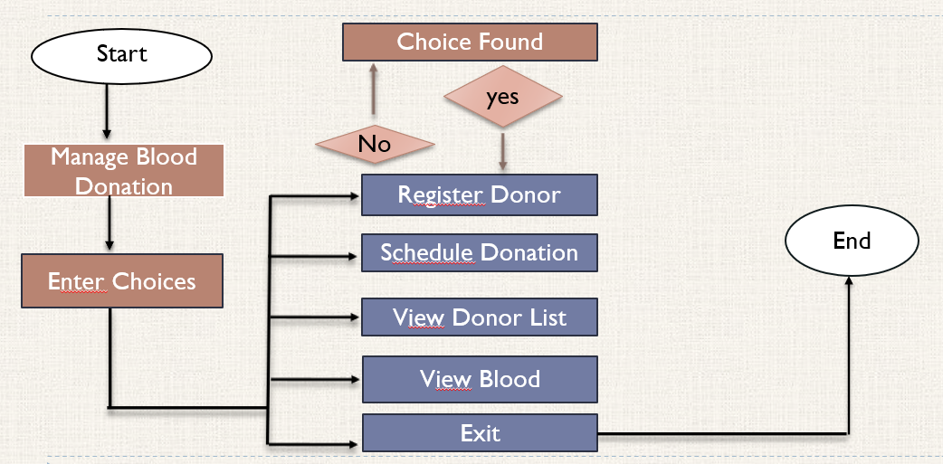
FLOW DIAGRAM

Slide 8
MODULE DESCRIPTION
1.Donor Registration Module: Allows donors to register with their personal details (name, age, blood type) and provides an option to update their information.
2.Donation Scheduling Module: Enables donors to schedule their donations by specifying a convenient date and time.
3.Donation History Module: Tracks and displays all past donations made by a donor, including donation dates and quantities.
4.Inventory Management Module: Manages the blood bank’s inventory, updating the quantity of each blood type as donations are made or used.
5.Donation Drive Organization Module: Allows blood banks to organize and schedule blood donation drives, track participation, and manage appointments.

Slide 9
MERITS
Efficiency: Simplifies and speeds up the blood donation process for both donors and healthcare organizations.
Automation: Reduces manual work by automating donor registrations, scheduling, and inventory management.
Improved Tracking: Donors and healthcare organizations can track donations, inventory levels, and schedules in real-time.
Enhanced Communication: Automated notifications can be implemented to remind donors of upcoming donations or schedule changes.

Slide 10
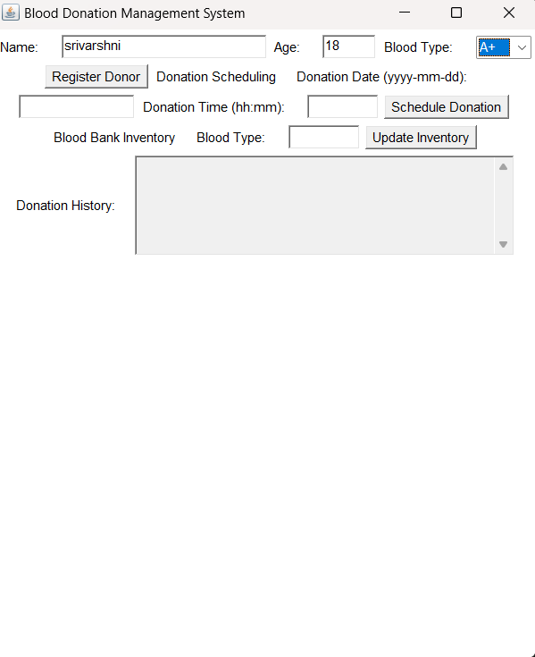
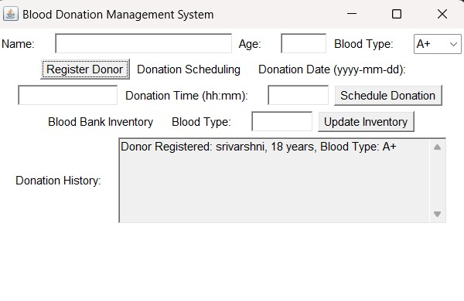
RESULT AND DISCUSSION

Slide 11
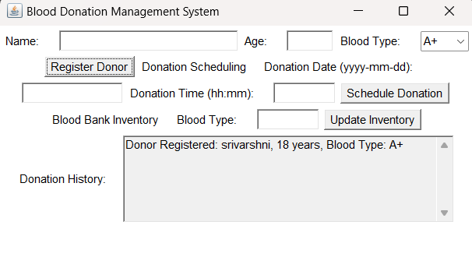
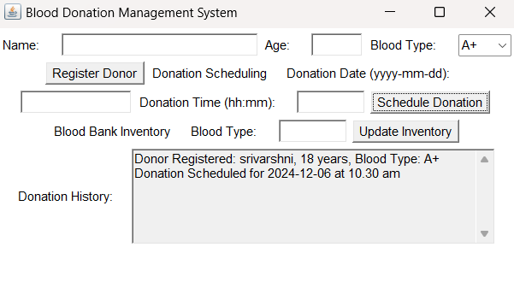

Slide 12
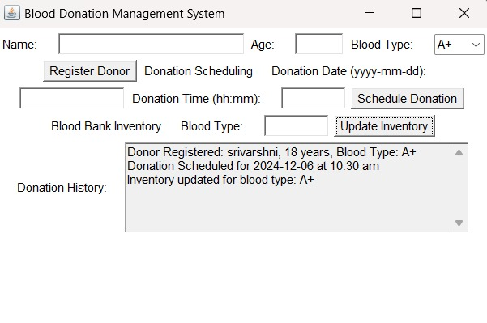

Slide 13
ANY QUERIES ?

Slide 14
THANK YOU

